Slide 1
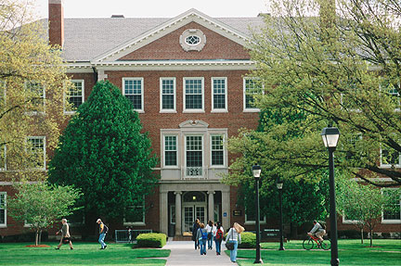


Radford University
Radford, Virginia
Presenter: Michael Bristol

Slide 2
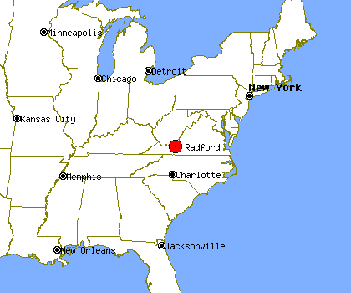
Where Are We Located?

Slide 3



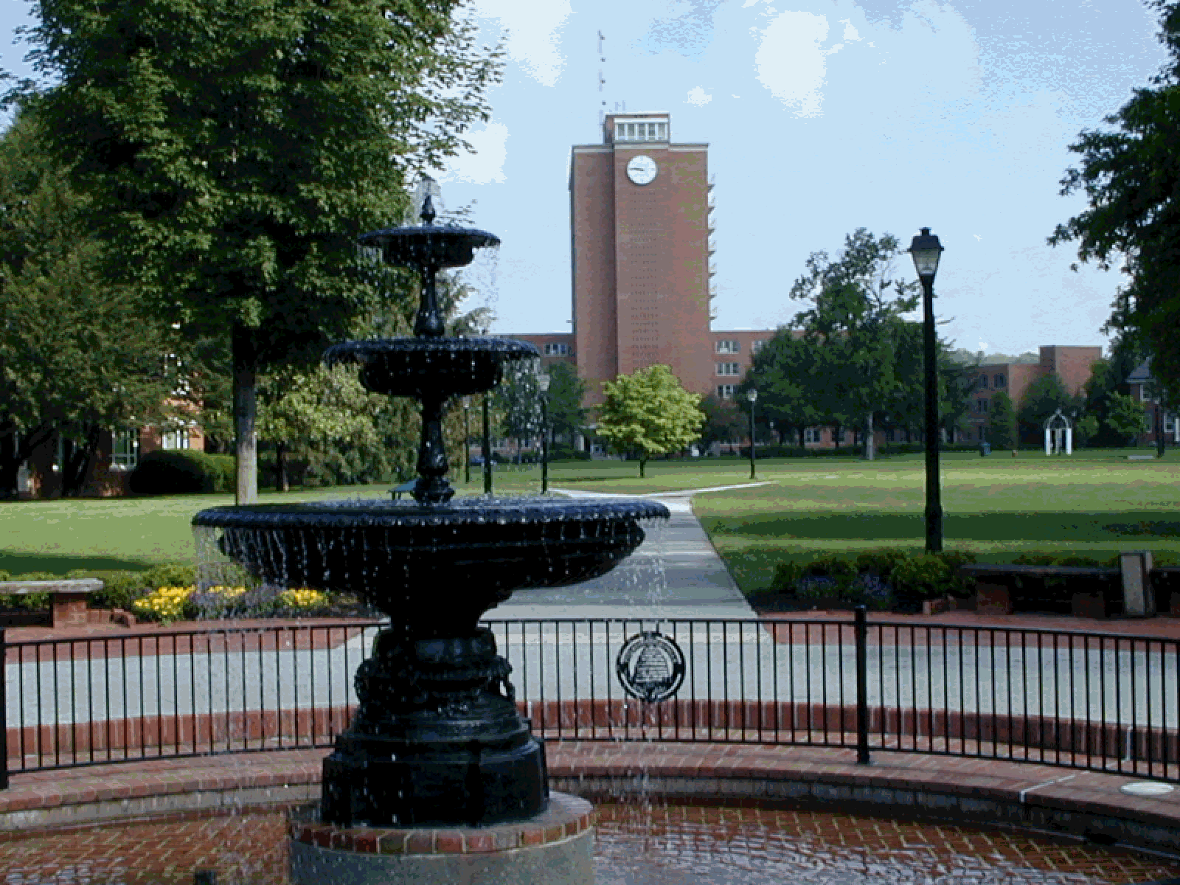
Why Consider This University?
Beautiful landscape
Great campus
Has great school spirit

Slide 4
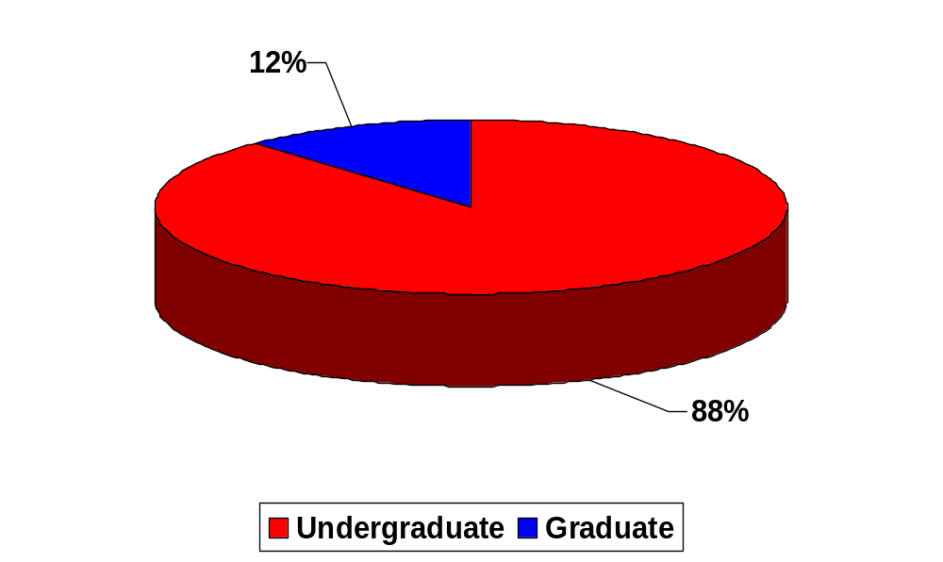
What Is The Student Population?

Slide 5

What are the Requirements?
HS Diploma
Average GPA 3.15
Combined SAT(2400)
1579
Average ACT
22

Slide 6
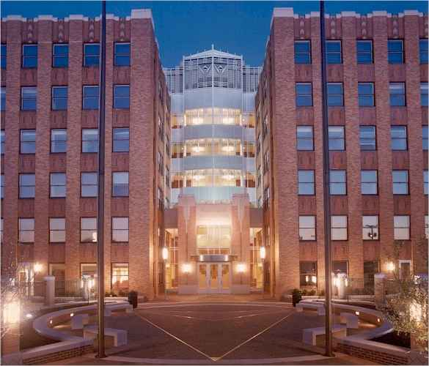
What Do We Offer?
Offers Bachelors, doctorates and Masters degrees
Has over 100+ sports programs
NCAA Division 1
First Year Students allow to have Cars

Slide 7
What Are The Costs?
 | In-state | Out-of-state
tuition and fees: | $6,536 | $15,550
Room and board: | $6,716 | $6,716
Books and supplies: | $877 | $877
Total: | $14,129 | $17,103

Slide 8

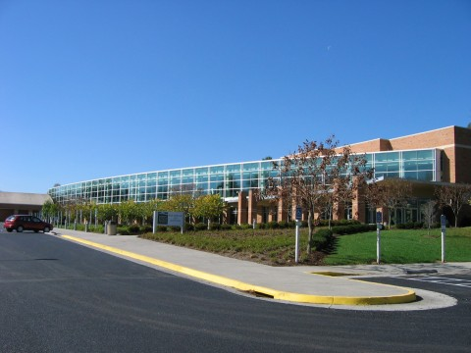


What Does The Area Offer?

Slide 9
Why Wait? Apply Today!
http://www.radford.edu/
Early Action (Non-Binding) Deadline: 15-Dec
Early Action Notification: 09-Jan
Regular Decision Deadline:01-Feb
Regular Decision Notification: Mid-March
Financial Aid Deadline:01-March

Slide 10
Any Questions
Where Are We Located?
Why Consider This University?
What Is The Student Population?
What are the Requirements?
What Do We Offer?
What Are The Costs?
What Does The Area Offer?
Why Wait? Apply Today!

